Slide 1


AI-driven
Software Engineering
Guardrails for the Age of Vibe Programming
Dr. Stefan Trenkwalder
Code Praxis GmbH · PyCon Austria 2026

Slide 2


https://github.com/Code-Praxis/pycon-at-2026-workshop-ai-tdd
Dr Stefan Trenkwalder Software Engineer

Slide 3
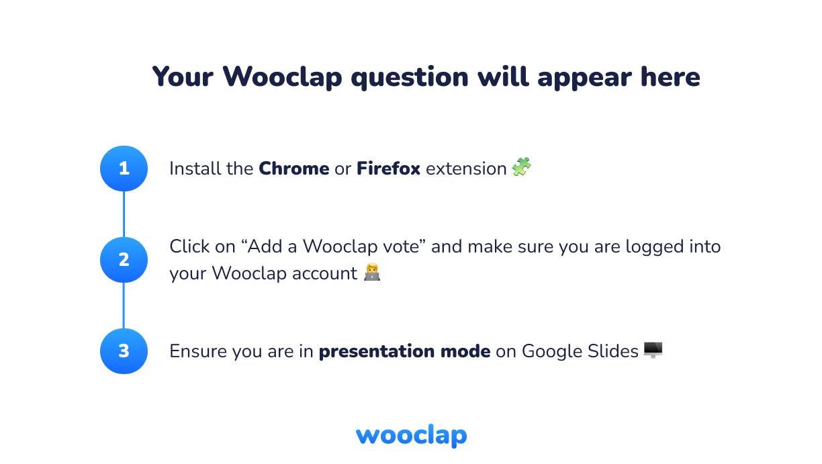

Slide 4

AI is just amazing …
Low Autonomy
High Autonomy
Inline Autocomplete
(Copilot)
Healthy Software is Engineered.
codepraxis.eu

Slide 5
AI is just amazing …
Low Autonomy
High Autonomy
Inline Autocomplete
(Copilot)
Chat Assistants
(ChatGPT)
Healthy Software is Engineered.
codepraxis.eu

Slide 6
AI is just amazing …
Low Autonomy
High Autonomy
Inline Autocomplete
(Copilot)
Chat Assistants
(ChatGPT)
AI-native IDEs
(Cursor)
Healthy Software is Engineered.
codepraxis.eu

Slide 7
AI is just amazing …
Low Autonomy
High Autonomy
Inline Autocomplete
(Copilot)
Chat Assistants
(ChatGPT)
AI-native IDEs
(Cursor)
Coding Agents
(Devin)
Healthy Software is Engineered.
codepraxis.eu

Slide 8
AI is just amazing …
Low Autonomy
High Autonomy
Inline Autocomplete
(Copilot)
Chat Assistants
(ChatGPT)
AI-native IDEs
(Cursor)
Coding Agents
(Devin)
Full-stack App Builders
(Lovable)
Healthy Software is Engineered.
codepraxis.eu

Slide 9
Usage
// ADOPTION
92% of US developers use AI coding tools daily (Hashnode 2026)
AI generates 46% of all new code
70% of engineers use 2–4 AI tools simultaneously
Healthy Software is Engineered.
codepraxis.eu

Slide 10
Usage without Trust
// ADOPTION
92% of US developers use AI coding tools daily (Hashnode 2026)
AI generates 46% of all new code
70% of engineers use 2–4 AI tools simultaneously
// CALLOUT
29 %
Trust in AI code accuracy
— Stack Overflow 2025
Healthy Software is Engineered.
codepraxis.eu

Slide 11
What is your biggest failure or frustration
with AI-generated code?

Slide 12
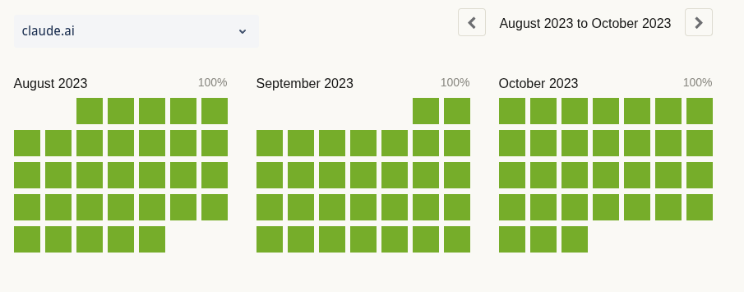
Claude.ai
Healthy Software is Engineered.
codepraxis.eu

Slide 13
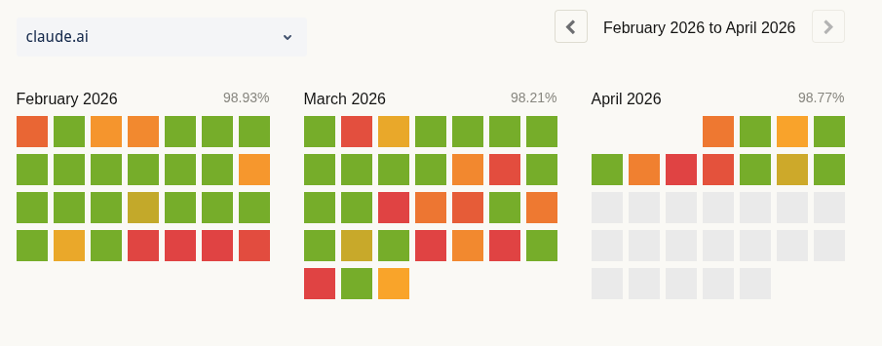
Claude.ai
Healthy Software is Engineered.
codepraxis.eu

Slide 14
Claude is not the only one …
AWS outage (Oct 2025): Netflix was down too
Healthy Software is Engineered.
codepraxis.eu

Slide 15
Claude is not the only one …
AWS outage (Oct 2025): Netflix was down too
GitHub: uptime dropped below 90%
Healthy Software is Engineered.
codepraxis.eu

Slide 16
Claude is not the only one …
AWS outage (Oct 2025): Netflix was down too
GitHub: uptime dropped below 90%
Stanford study (Perry/Boneh):
88% of developers report negative AI impacts on code quality (Sonar 2026)
53% note AI produces code that "looks correct but is unreliable"
45% report debugging AI code takes more time than writing it manually
80% of developers bypass security policies when using AI tools (Snyk)
Only 10% scan AI-generated code before shipping
Healthy Software is Engineered.
codepraxis.eu

Slide 17
Where do we go from here?

Slide 18
Where do we go from here?
Guard Rails
We know this problem .. We dealt with this for decades

Slide 20
Low Autonomy
High Autonomy
Inline Autocomplete
(Copilot)
Chat Assistants
(ChatGPT)
AI-native IDEs
(Cursor)
Coding Agents
(Devin)
Full-stack App Builders
(Lovable)
Healthy Software is Engineered.
codepraxis.eu

Slide 21
Low Autonomy
High Autonomy
Inline Autocomplete
(Copilot)
Chat Assistants
(ChatGPT)
AI-native IDEs
(Cursor)
Coding Agents
(Devin)
Full-stack App Builders
(Lovable)
Industry
Healthy Software is Engineered.
codepraxis.eu

Slide 22
Low Autonomy
High Autonomy
Inline Autocomplete
(Copilot)
Chat Assistants
(ChatGPT)
AI-native IDEs
(Cursor)
Coding Agents
(Devin)
Full-stack App Builders
(Lovable)
No Influence
Industry
Healthy Software is Engineered.
codepraxis.eu

Slide 23


Guardrails: …
01
Formatter enforcing
For consistent code
Healthy Software is Engineered.
codepraxis.eu

Slide 24


Guardrails: …
01
Formatter enforcing
For consistent code
mypy
02
Linter, Security Scanners, (Reviewing) enforcing
For consistent typing, coding standards, security standards, …
Healthy Software is Engineered.
codepraxis.eu

Slide 25
Guardrails: …
01
Formatter enforcing
For consistent code
mypy
02
Linter, Security Scanners, (Reviewing) enforcing
For consistent typing, coding standards, security standards, …
03
Test Suite
For correct behaviour
Healthy Software is Engineered.
codepraxis.eu

Slide 26
Guardrails: …
01
Formatter enforcing
For consistent code
02
Linter, Security Scanners, (Reviewing) enforcing
For consistent typing, coding standards, security standards, …
03
Test Suite
For correct behaviour
Healthy Software is Engineered.
codepraxis.eu

Slide 27
We need a Workflow that guarantees tests

Slide 28
A Workflow that guarantees tests
Test-Driven Development

Slide 29
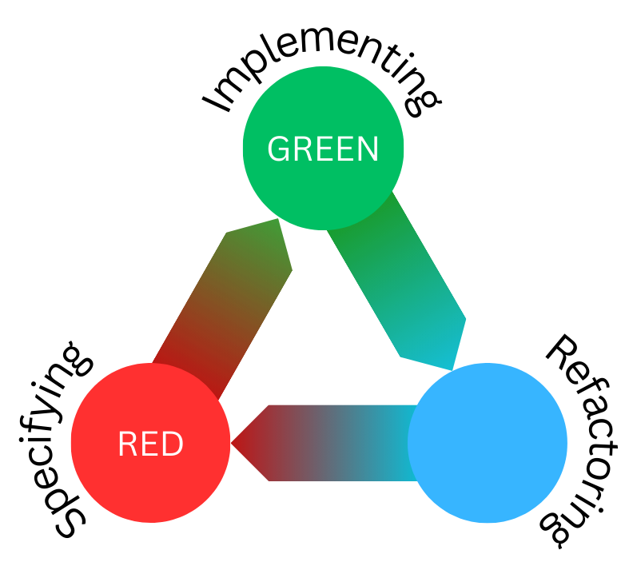
Write a failing test (specify a desired behaviour)
Write production code to make it pass
(implement the behaviour)
Refactor the solution (clean the code up, look at design)

Slide 30
Laws of Test-Driven Development (TDD)
Only write production code to make a failing test pass
Don’t write more test code than is sufficient to fail
Don’t write more production code than is sufficient to pass a failing test
Healthy Software is Engineered.
codepraxis.eu

Slide 31
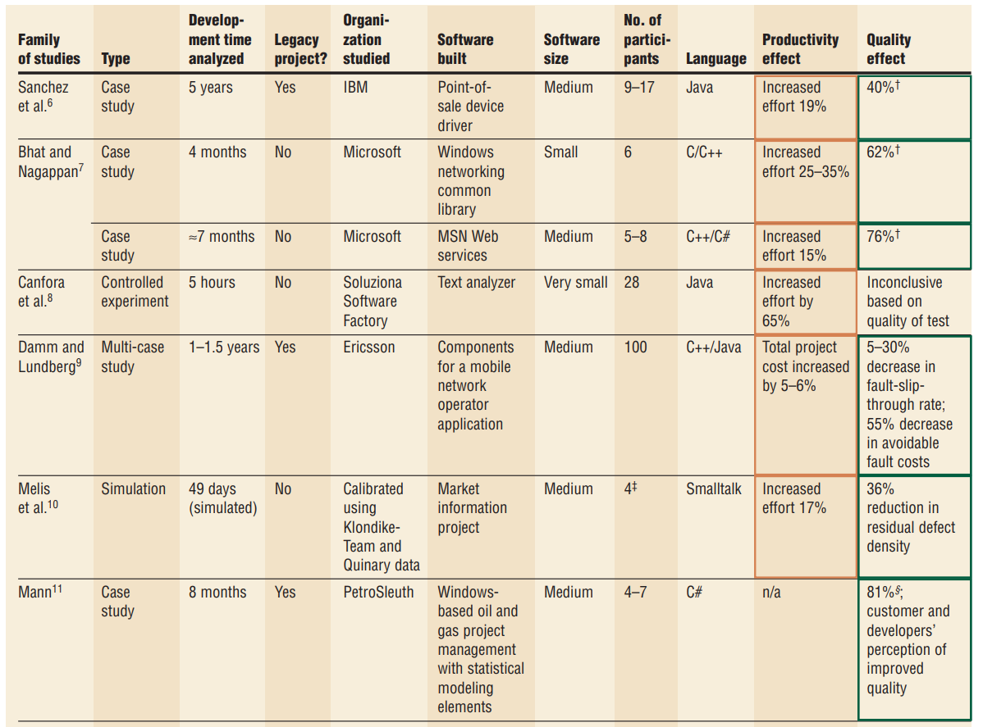
TDD Side Effects
6-35% slower
40-80% fewer defects
Jeffries, Ron, and Grigori Melnik. "Guest Editors' Introduction: TDD--The Art of Fearless Programming." IEEE Software 24.3 (2007): 24-30.
Healthy Software is Engineered.
codepraxis.eu

Slide 32
TDD Side Effects
You naturally build up a comprehensive test suite!
Healthy Software is Engineered.
codepraxis.eu

Slide 33
https://github.com/Code-Praxis/pycon-at-2026-workshop-ai-tdd

Slide 34
Exercise: Shipping Costs
The application must calculate shipping costs based on the following rules:
1. Base Rate: 5.00 € flat fee for any shipment.
2. Weight Tiers:
- 0 to 5 kg: 1.00 € per kg
- Over 5 kg to 20 kg: 1.50 € per kg
- Over 20 kg: 2.00 € per kg
3. Distance Zones:
- Zone A (Local): 1x multiplier
- Zone B (Domestic): 1.5x multiplier
- Zone C (International): 2.5x multiplier
4. Express Delivery: Adds a flat 15.00 € surcharge *after* all other calculations.
5. Edge Cases:
- Negative weight or distance should raise an `ValueError`.
- Maximum weight is 100 kg; exceeding this raises a `ValueError`.
Healthy Software is Engineered.
codepraxis.eu

Slide 35
Manual TDD Exercise
— To understand the workflow

Slide 36
Retrospective with focus on the Workflow
Cons
Slow(er)
Double the effort (twice as much to maintain)
Rigid rigour
Different to how programming is taught / learned
Pros
Small iterations/improvements
Quick feedback loop (on correctness and design)
Behaviour specifications are tested repeatedly
Fixed step to improve the code/design/architecture
Different roles for each step
Healthy Software is Engineered.
codepraxis.eu

Slide 37
Prompt Only
— To get started with AI

Slide 38
Retrospective on Prompting Only
Review the code
Review is more difficult than writing -> LGTM
Cognitive Debt : Your Brain on ChatGPT: Accumulation of Cognitive Debt when Using an AI Assistant for Essay Writing Task - Kosmyna et al. (Artificial Intelligence) - https://arxiv.org/abs/2506.08872
Comprehension Debt:
https://margaretstorey.com/blog/2026/02/09/cognitive-debt/
https://martinfowler.com/fragments/2026-02-13.html
How to Kill the Code Review - https://www.latent.space/p/reviews-dead
Healthy Software is Engineered.
codepraxis.eu

Slide 39
Retrospective on Prompting Only
The Anthropic RCT (2025/2026) - https://www.anthropic.com/research/AI-assistance-coding-skills
52 junior engineers learning a new library
Manual coding group: 67%
AI-assisted group: 50%
Full delegation to AI: Below 40% (effectively failing)
The largest gap appeared in debugging and skill to validate AI code
Healthy Software is Engineered.
codepraxis.eu

Slide 40
Retrospective on Prompting Only
METR RCT (July 2025) - https://metr.org/blog/2025-07-10-early-2025-ai-experienced-os-dev-study/
16 experienced open-source developers, 246 real issues, their own codebases:
Predicted speed gain (before study): +24%
Perceived speed gain (after study): +20%
Healthy Software is Engineered.
codepraxis.eu

Slide 41
Retrospective on Prompting Only
METR RCT (July 2025) - https://metr.org/blog/2025-07-10-early-2025-ai-experienced-os-dev-study/
16 experienced open-source developers, 246 real issues, their own codebases:
Predicted speed gain (before study): +24%
Perceived speed gain (after study): +20%
Actual measured speed: -19% (slower)
Healthy Software is Engineered.
codepraxis.eu

Slide 42
Retrospective on Prompted TDD
The Stanford study (Perry/Boneh) - https://ee.stanford.edu/dan-boneh-and-team-find-relying-ai-more-likely-make-your-code-buggier
Developers using AI write significantly less secure code and are more likely to believe it is secure.
Healthy Software is Engineered.
codepraxis.eu

Slide 43
Prompted TDD
— Guardrail your AI

Slide 44
Retrospective on TDD with AI
TDFlow: Agentic Workflows for Test Driven Development - Han et al. (EACL 2026) - https://arxiv.org/abs/2510.23761
88.8% pass rate on SWE-Bench Lite (an absolute improvement of 27.8% over the next best system)
Best results when tests have been witten by developers.
Enhancing LLM Code Generation Capabilities through Test-Driven Development and Code Interpreter - Jalil et al. (AACL-IJCNLP 2025) - https://arxiv.org/abs/2511.12823
Small open-source models with TDD and CI (feedback) outperformed expensive/commerical models.
Healthy Software is Engineered.
codepraxis.eu

Slide 45
Retrospective on Prompted TDD
Repetitive
Copy paste promts
Really depends on the prompt
Review the code after each step
Review is more difficult than writing
Most just approve (LGTM)
Healthy Software is Engineered.
codepraxis.eu

Slide 46
Agentic TDD Exercise
— High-throughput coding

Slide 47

Thank You.
Healthy Software is Engineered.
Dr. Stefan Trenkwalder · Code Praxis GmbH
stefan@codepraxis.eu · codepraxis.eu · Vienna, Austria
linkedin.com/in/stefantrenkwalder

